Slide 1
An Project Report
On
ETHICAL HACKING
For
Website Penetration
Made & Submitted by-Abhinav Kabra Submitted to-Technophilia
Designation-BTECH 2nd YR Student
GitHub link- https://github.com/akbundi/technophilia

Slide 2
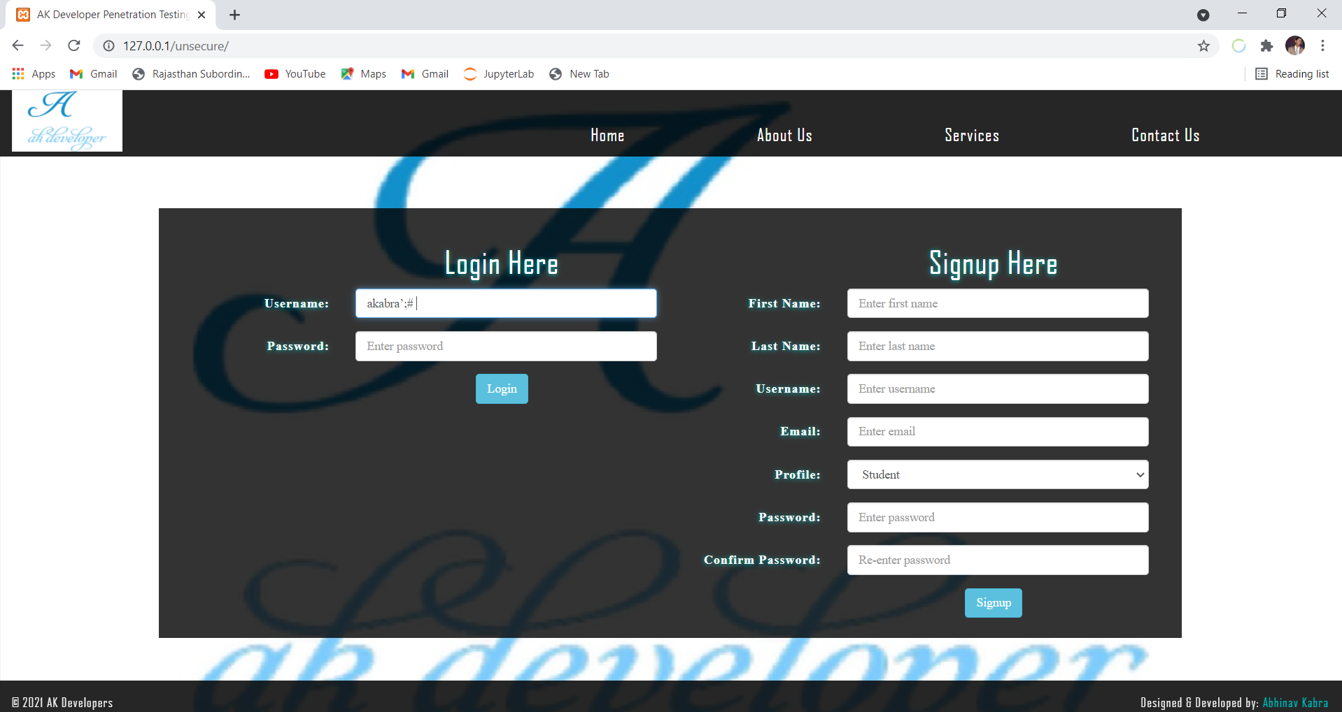
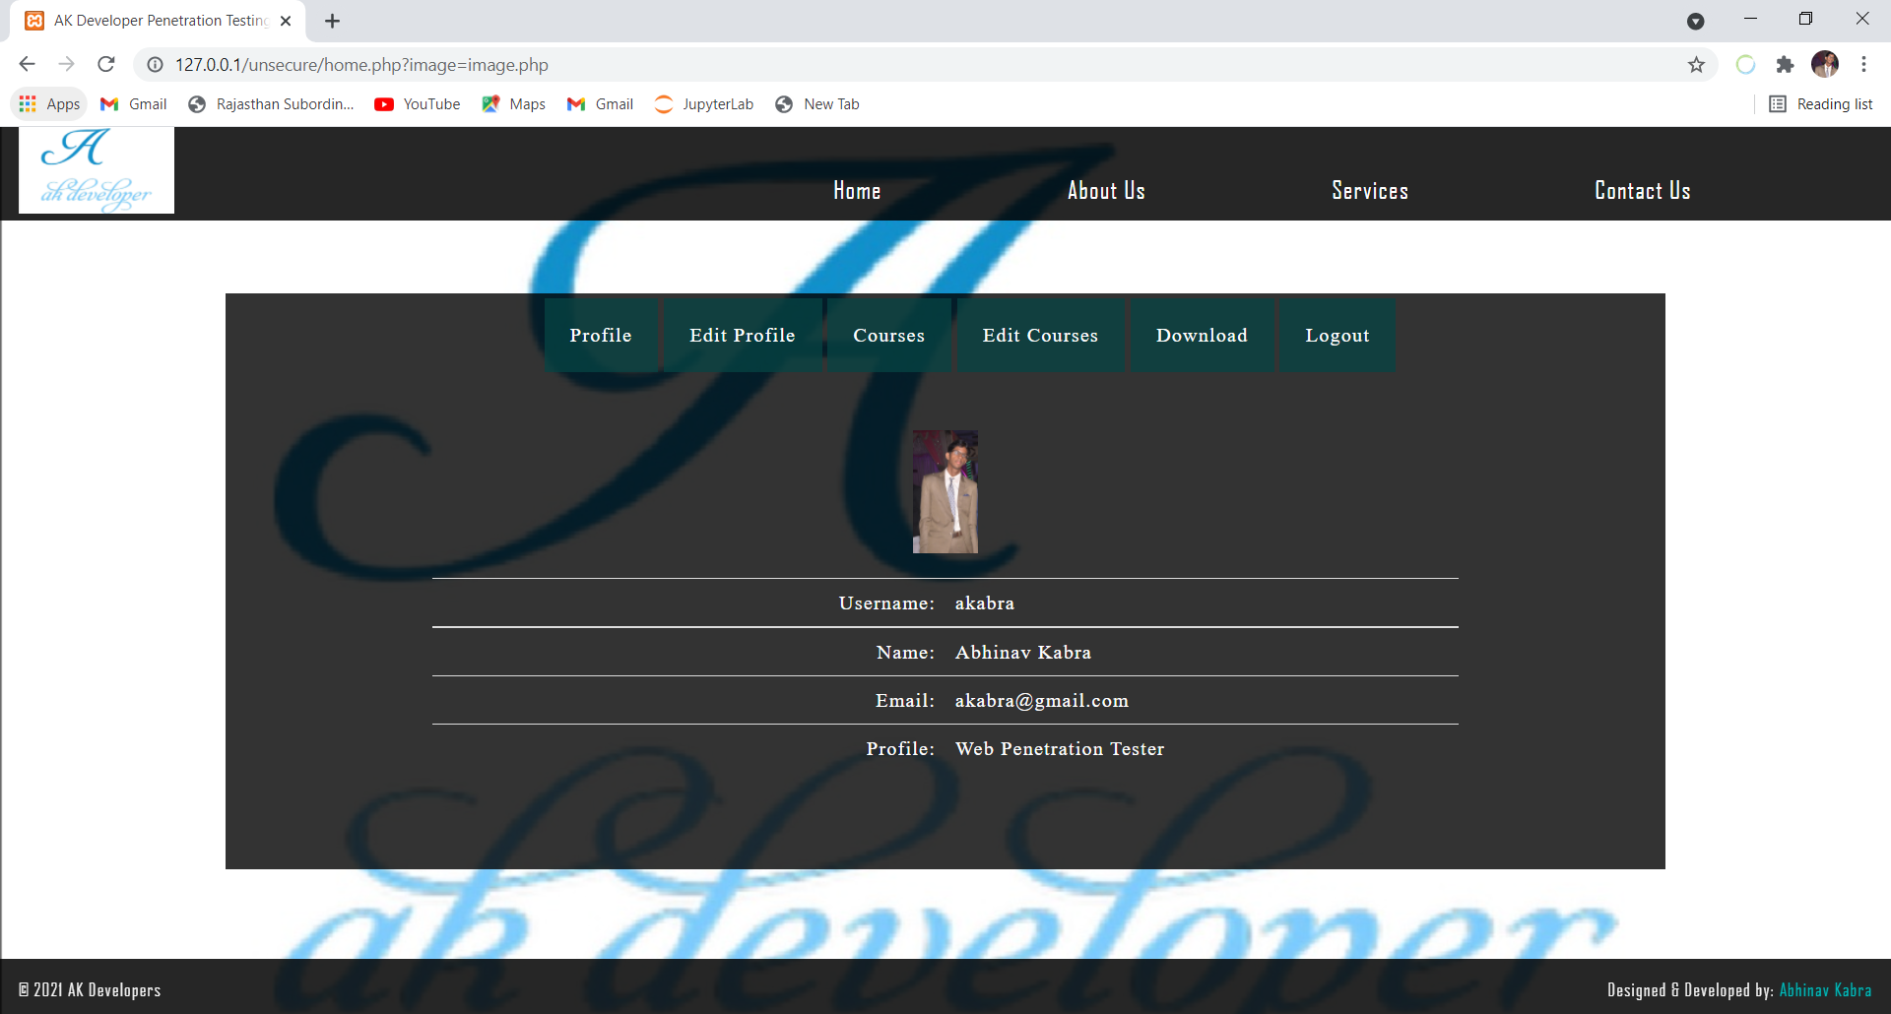
1) a)If username is known-When we type akabra’;# as
username on my local host unsecure website then it gets
login which you can see in the photo attached in fig1 and fig2
Whose code is in folder unsecure include login.php file in
github’s technophilla Repository
Website Penetration

Slide 3
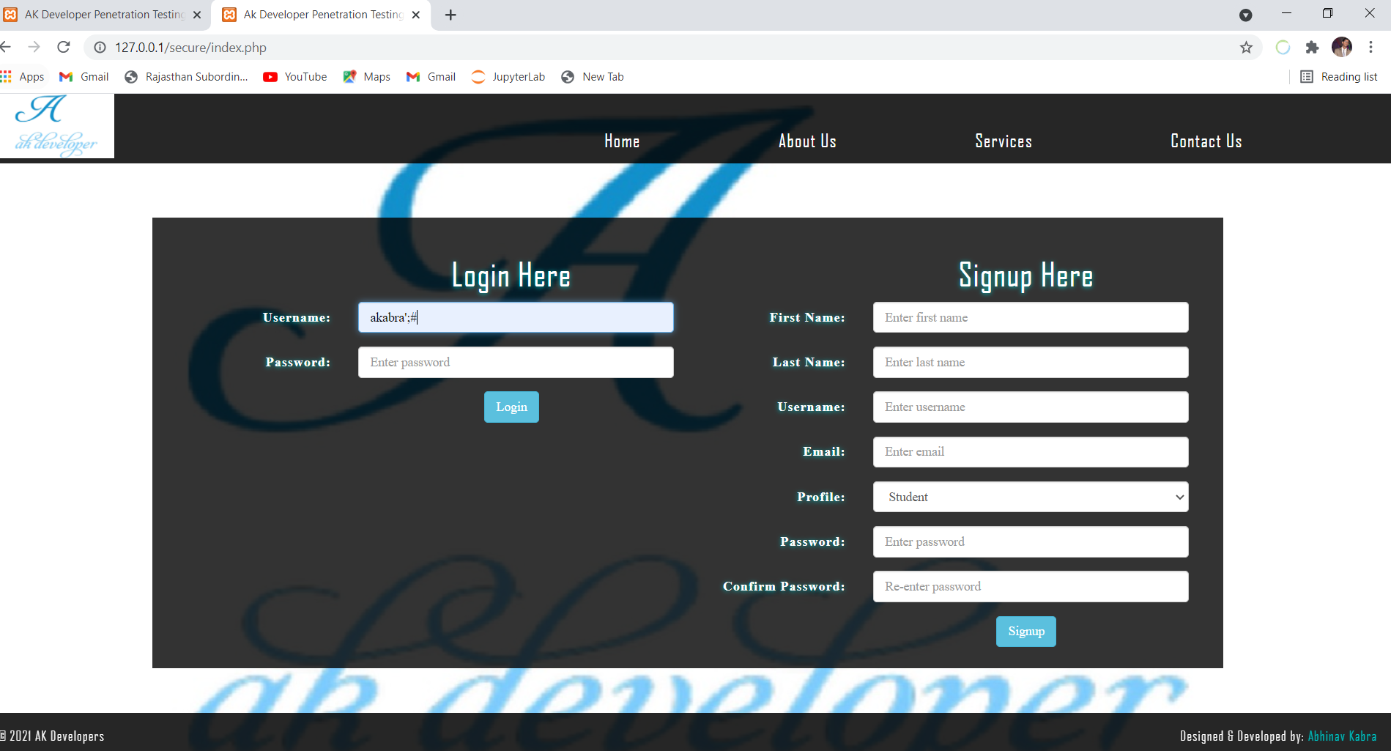
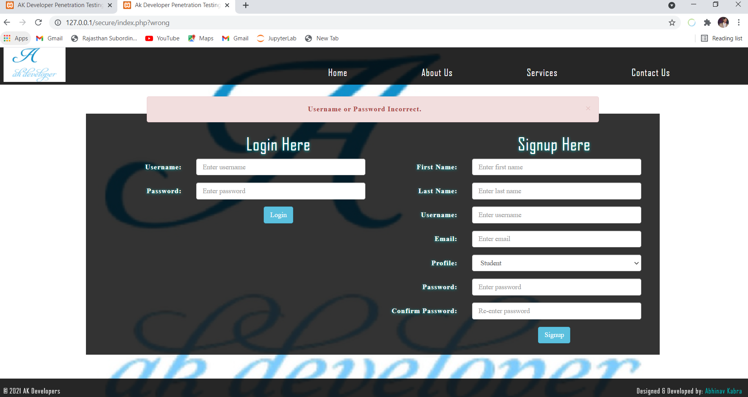

b) When we type akabra’;# as username on
my local host secure website then it does not get login
which you can see in the photo attached in fig3 and fig4
whose code is in folder secure include login.php file in
github’s technophilla Repository
Website Penetration

Slide 4
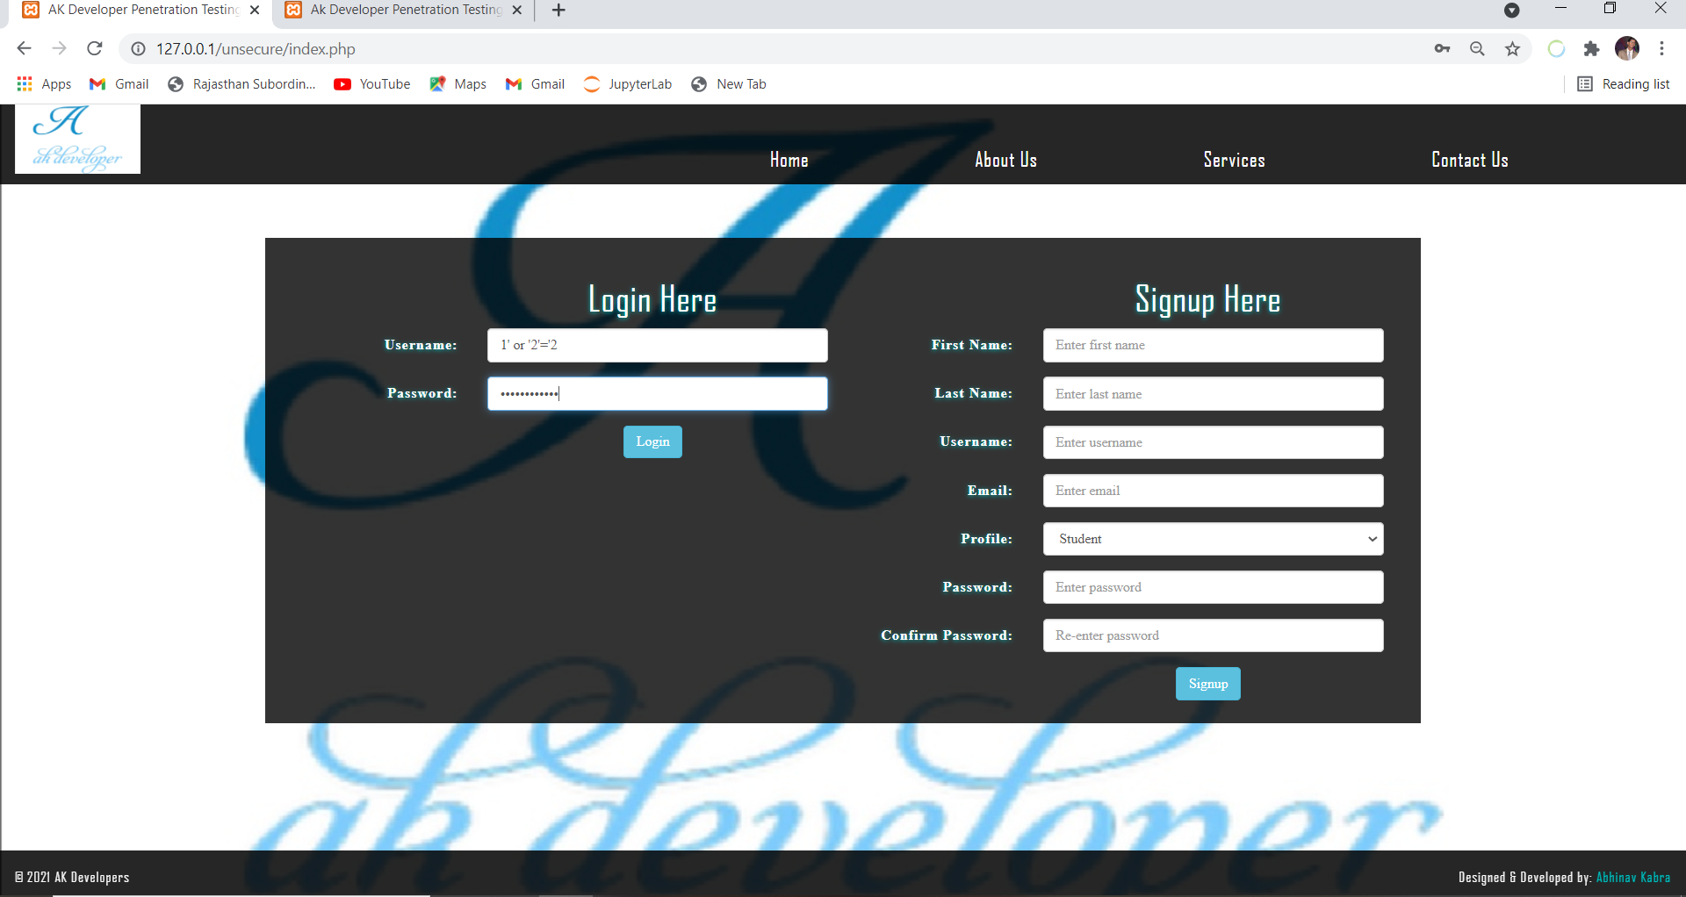
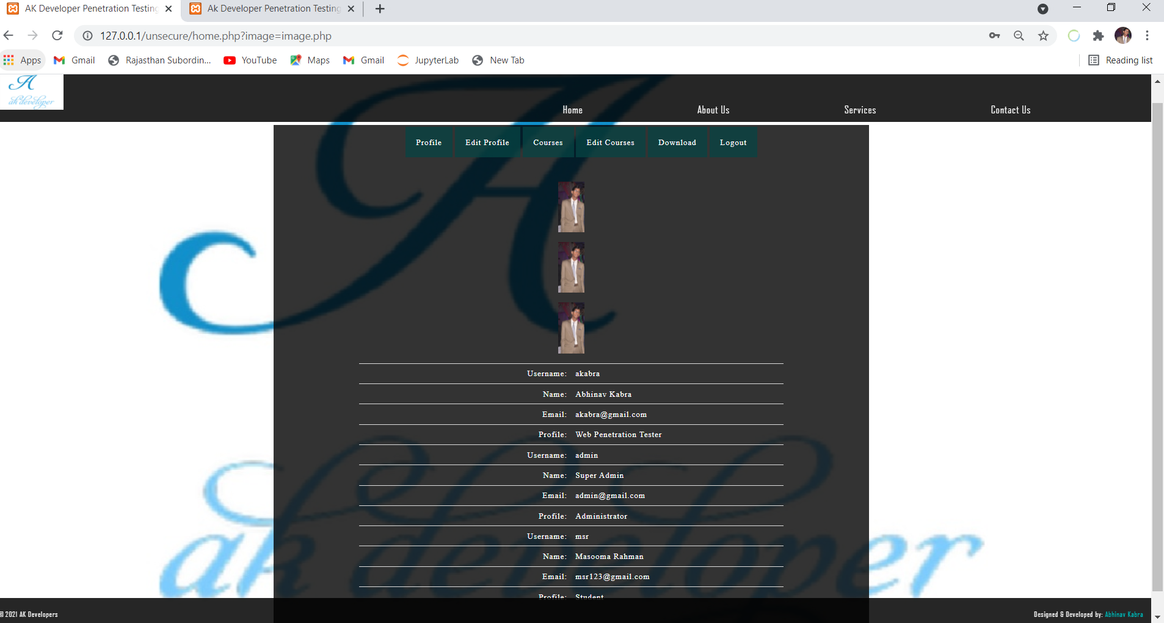
2) a)If username & password is not known-When
we type 1' or '2'='2 as username & password on
my local host unsecure website then it gets
login which you can see in the photo attached in
fig5 and fig6Whose code is in folder unsecure
include login.php file in github’s technophilla rep
Website Penetration

Slide 5
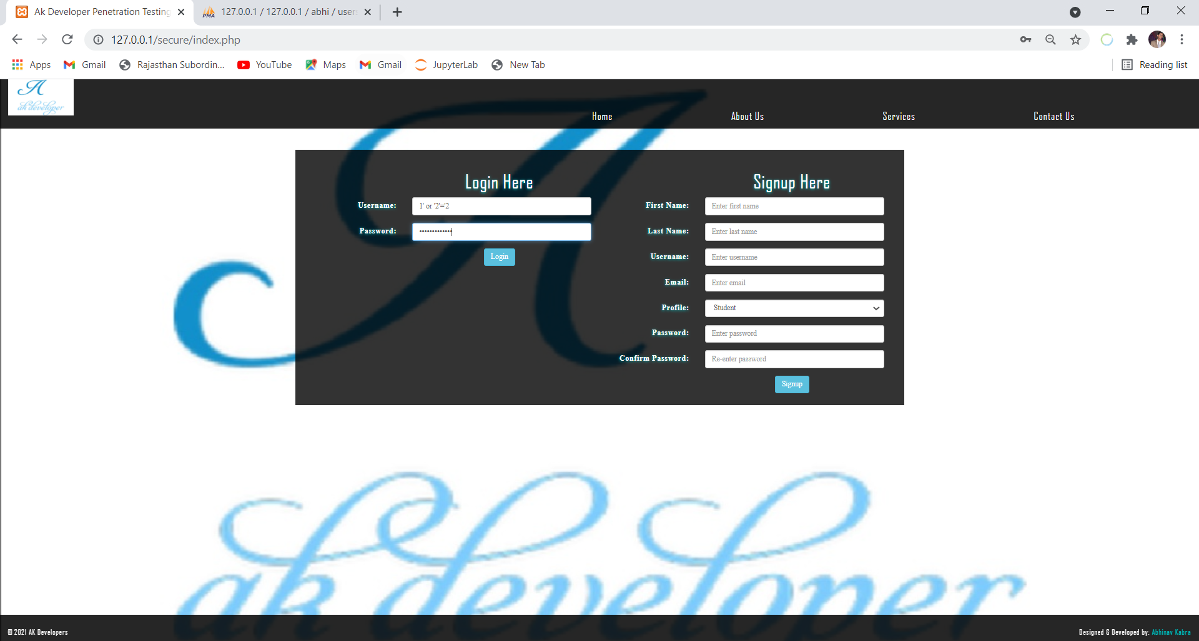
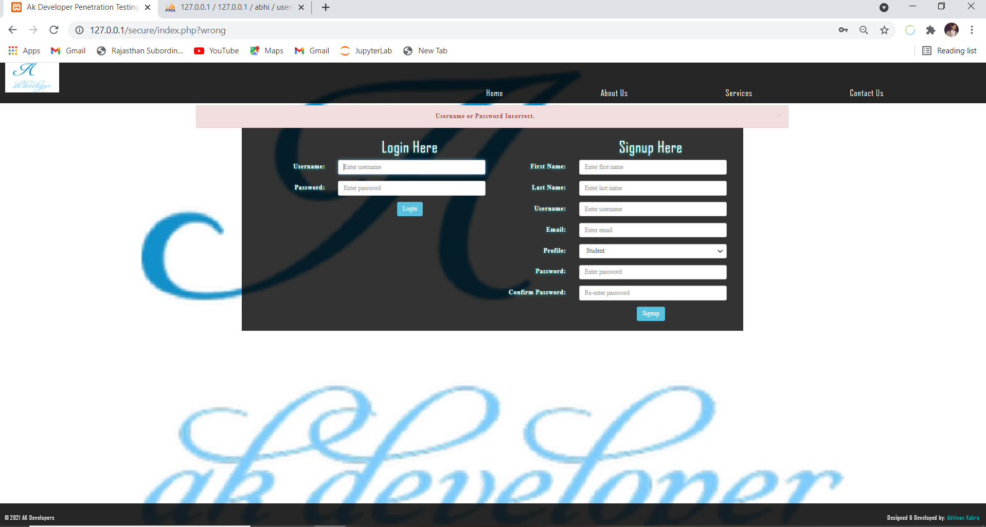
2 b)If username & password is not known-When
we type 1' or '2'='2 as username & password on
my local host secure website then it does not gets
login which you can see in the photo attached in
fig5 and fig6Whose code is in folder secure
include login.php file in github’s technophilla rep

Slide 6
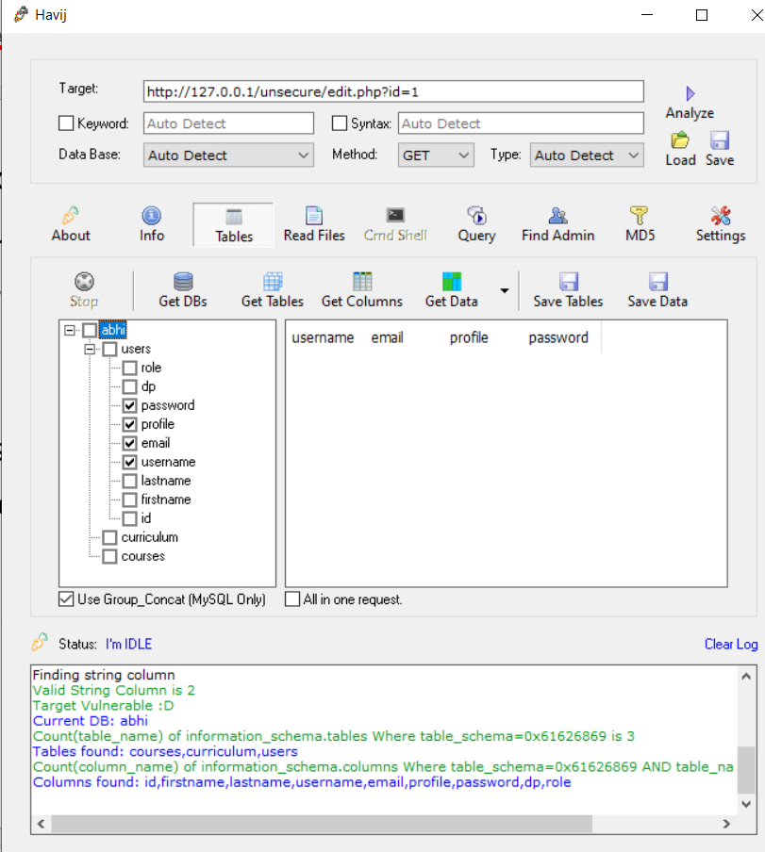
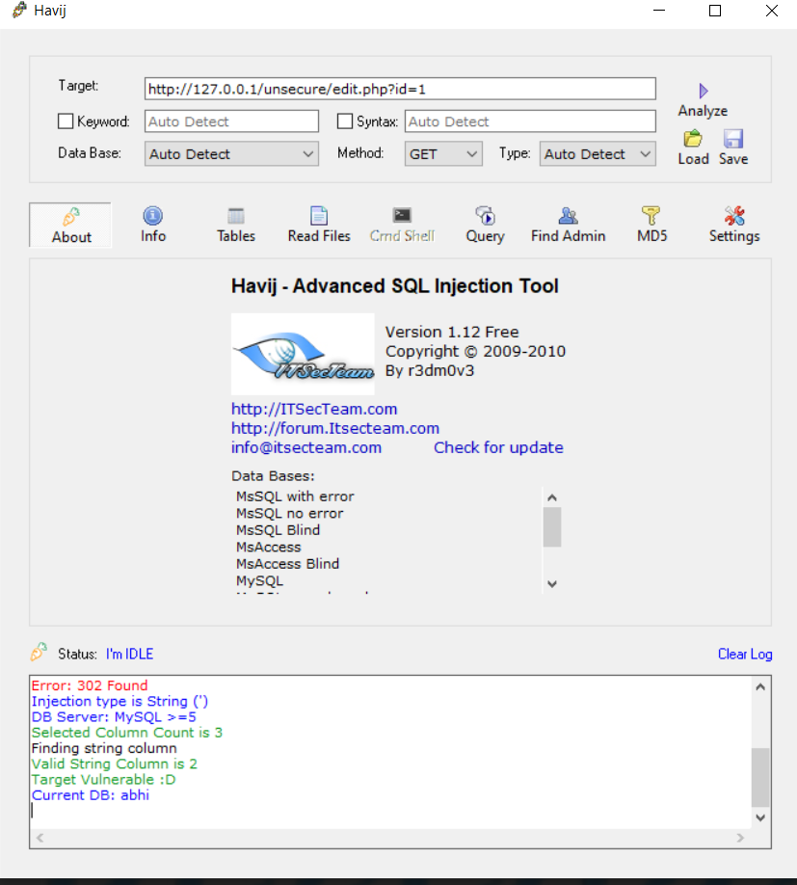
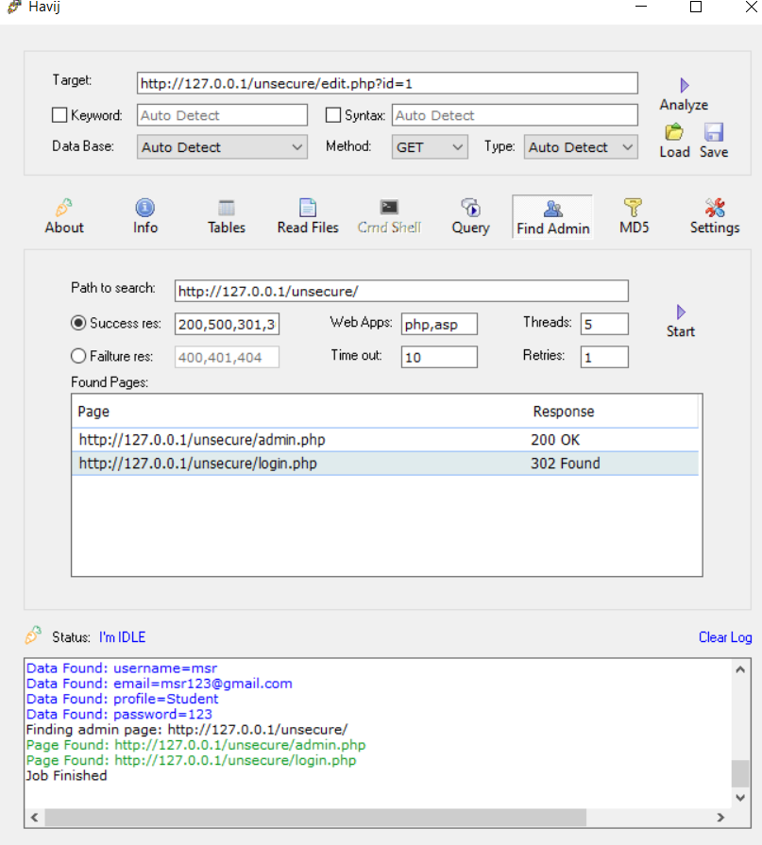
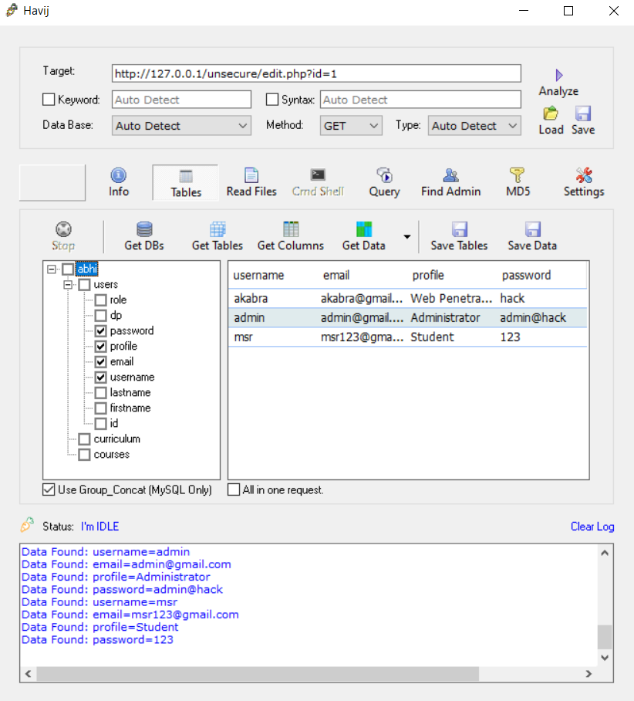
Havij-It is advanced sql injectionTool to detect vulnerabilities
of Web page. To use it-a)1)put Vulnerable Site in target field
which is my Unsecured local host Website & click on analyse
.2)It get current dbclick on get Tables then select tables like
user And click on get column.3)select Email, user , password
& click on Get data. 4)Click on get admin Page then start &
use this page By entering already present User & password
whose code is in folder unsecure include edit.php file in
github’s technophilla Repository
Website Penetration

Slide 7
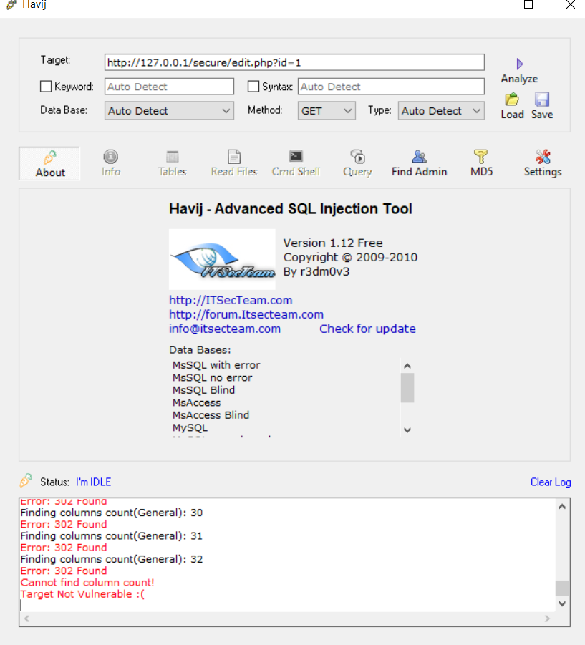
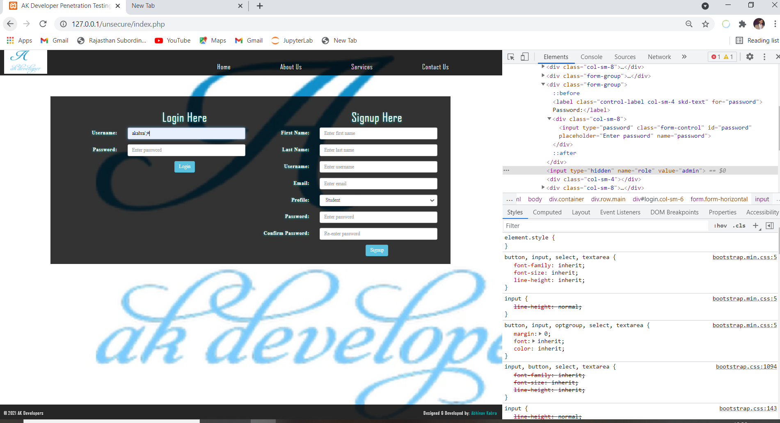
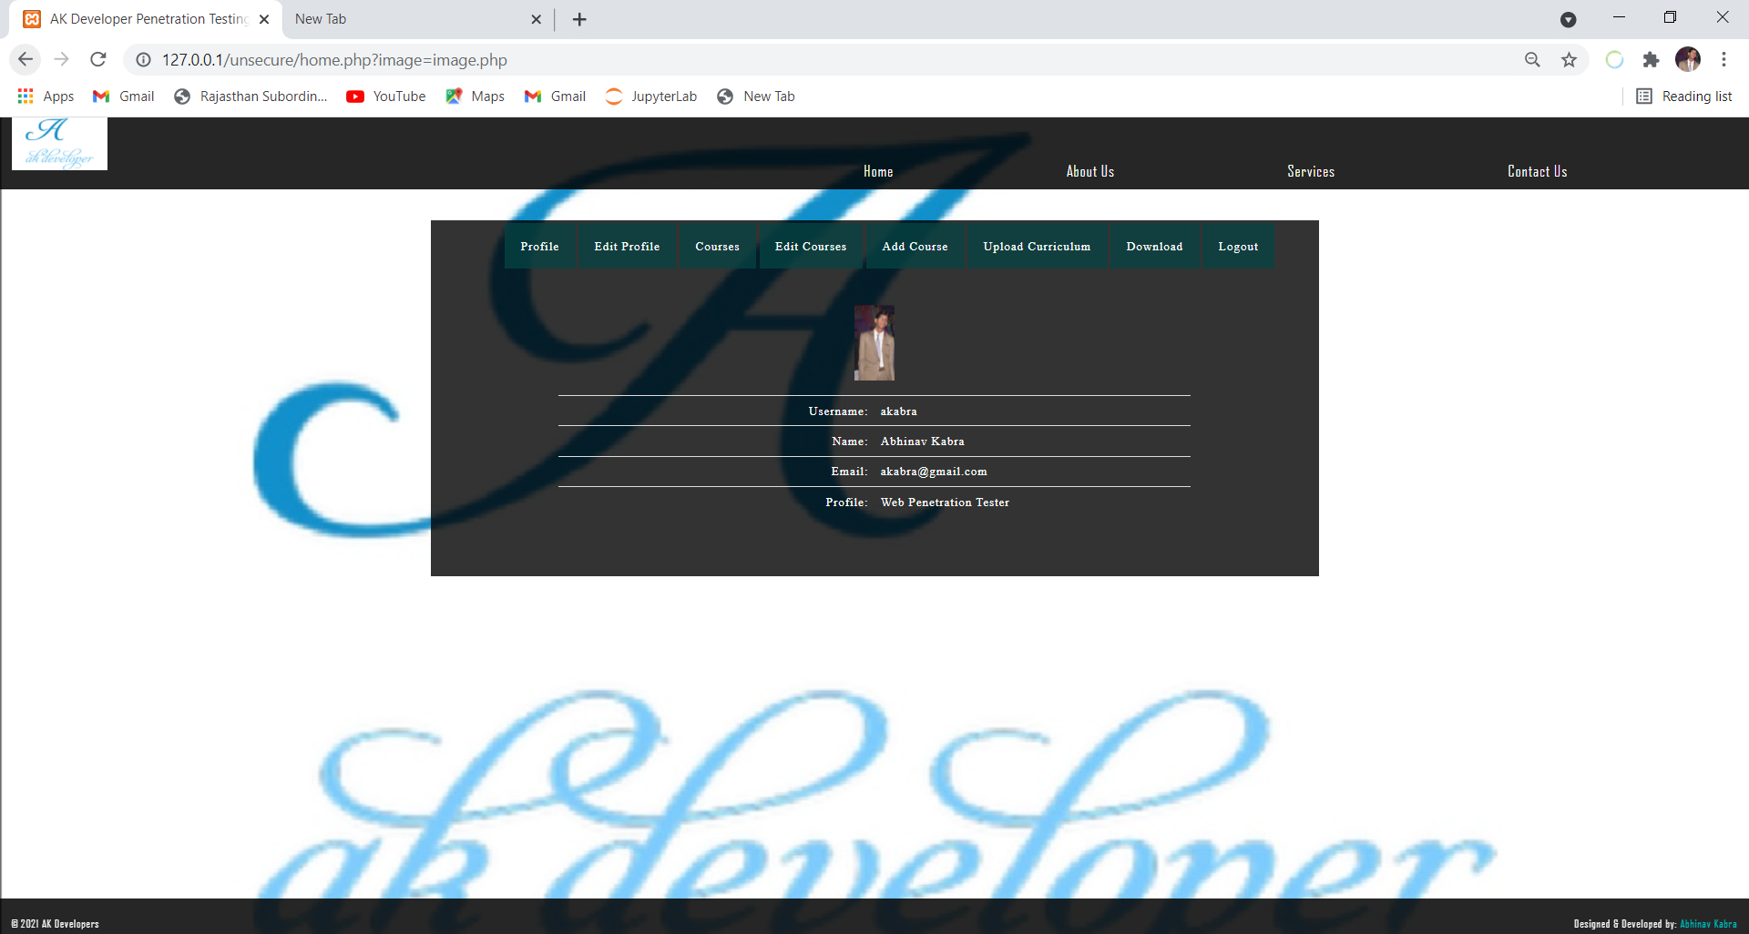
b) If I put Vulnerable Site in target field which is my secured local host
Website & click on analyse and I will not get current db so unable to
Fetch any data of this website whose code is in folder secure include
edit.php file in github’s technophilla Repository
Data tampering-1) If have login details of user of my local host unsecured website &
& I want to convert user to admin then from password section, use right click & click on
inspect. After that we find role option so change it to admin & we get admin powers by
using user login whose code is in folder unsecure include login.php file in
github’s technophilla Repository .
.
Website Penetration

Slide 8
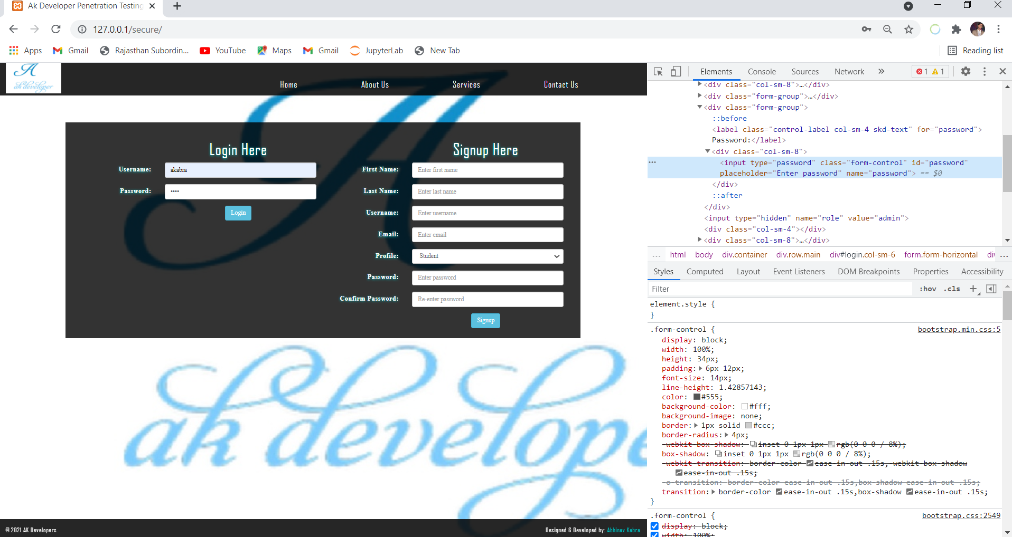

2) If have login details of user of my local host secured website &
& I want to convert user to admin then from password section, use right
click & click on inspect. After that we find role option so change it to admin
& we would not get admin powers by using user login whose code is in
folder secure include login.php file in github’s technophilla Repository
Website Penetration

Slide 9
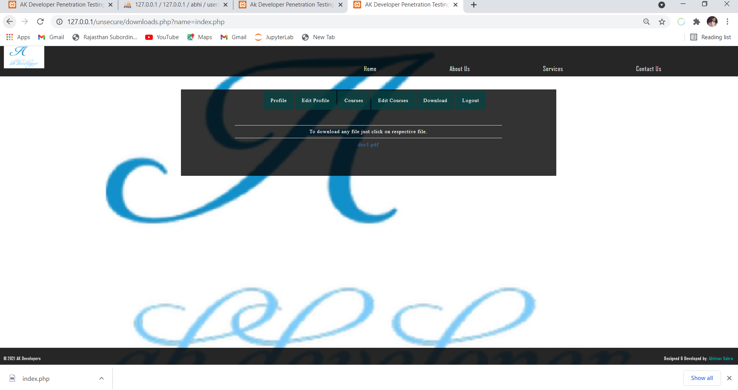
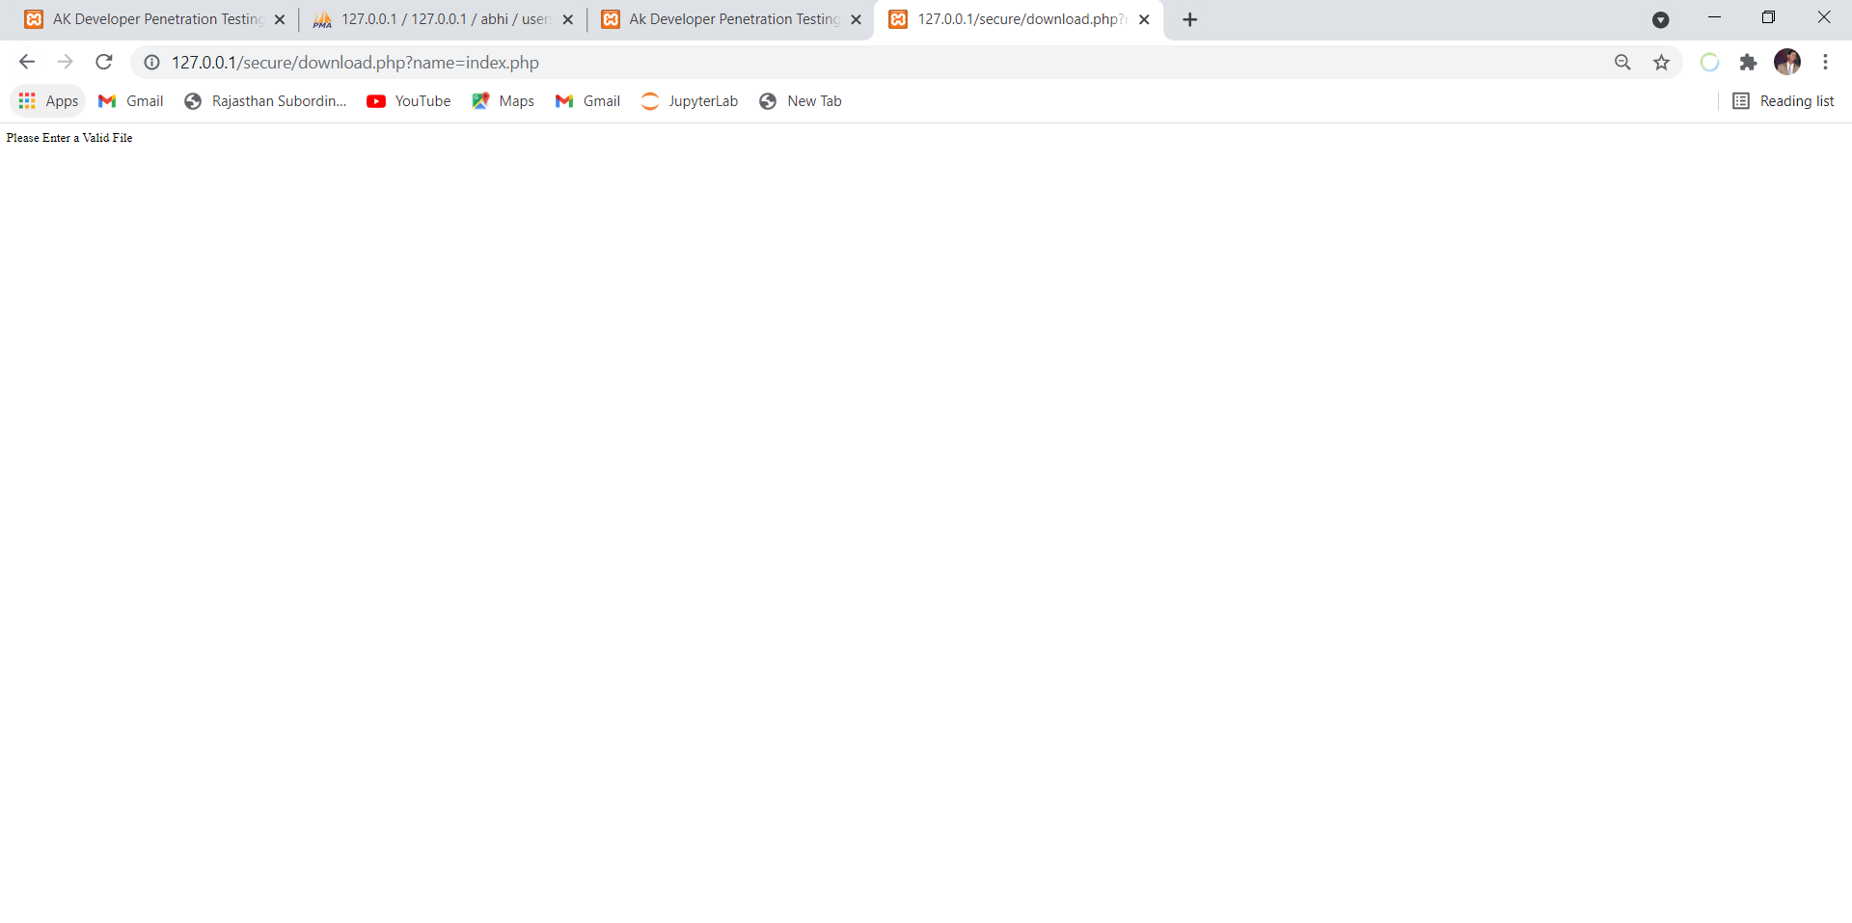
Directory Traversal(DT)-This attack is possible where download
Option is present.
1) If I will execute DT on my unsecured local host website
Then it download php file(like index.php , header.php, etc)
Whose code is in folder unsecure include
download.php file in github’s technophilla Repository
2) If I will execute DT on my secured local host website
Then it does not download php file(like index.php , header.php, etc)
Whose code is in folder secure include
download.php file in github’s technophilla Repository
Website Penetration

Slide 10


LFI(Local File Inclusion)-1)If we already login & include local file like shadow.txt
In url of my unsecured local host website then it gives username
& password Whose code is in folder unsecure include
home.php file in github’s technophilla Repository
2)If we already login & include local file like shadow.txt
In url of my secured local host website then it gives error that this is not
a valid file whose code is in folder secure include
home.php file in github’s technophilla Repository
Website Penetration

Slide 11
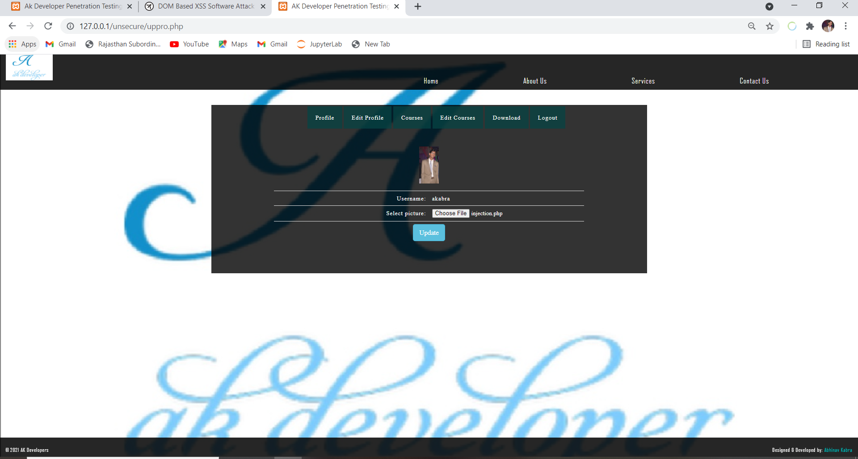
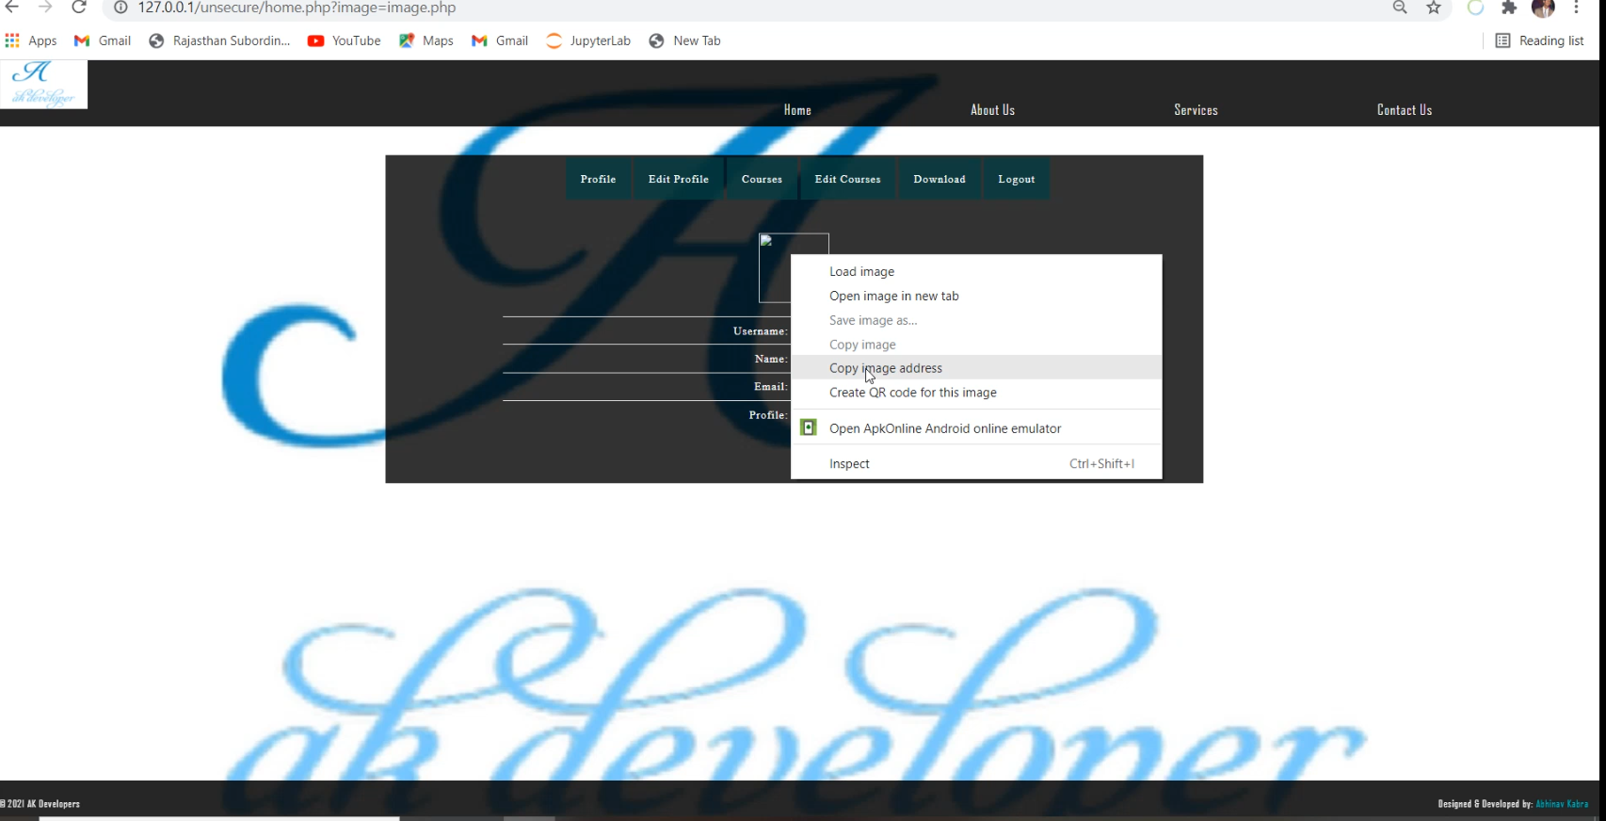
Shell injection-1)I use some code(github technophilla repository
file injection.php) which can inserted where we find
choose file option & if execute we get cmd access
Of server. I login on my unsecured local host website then
Visit edit profile and in choose file option add this php file,
After that click on update then copy image address and
paste in browser you will get cmd access file whose code is in
folder unsecure include upload.php file in github’s technophilla
Repository

Slide 12
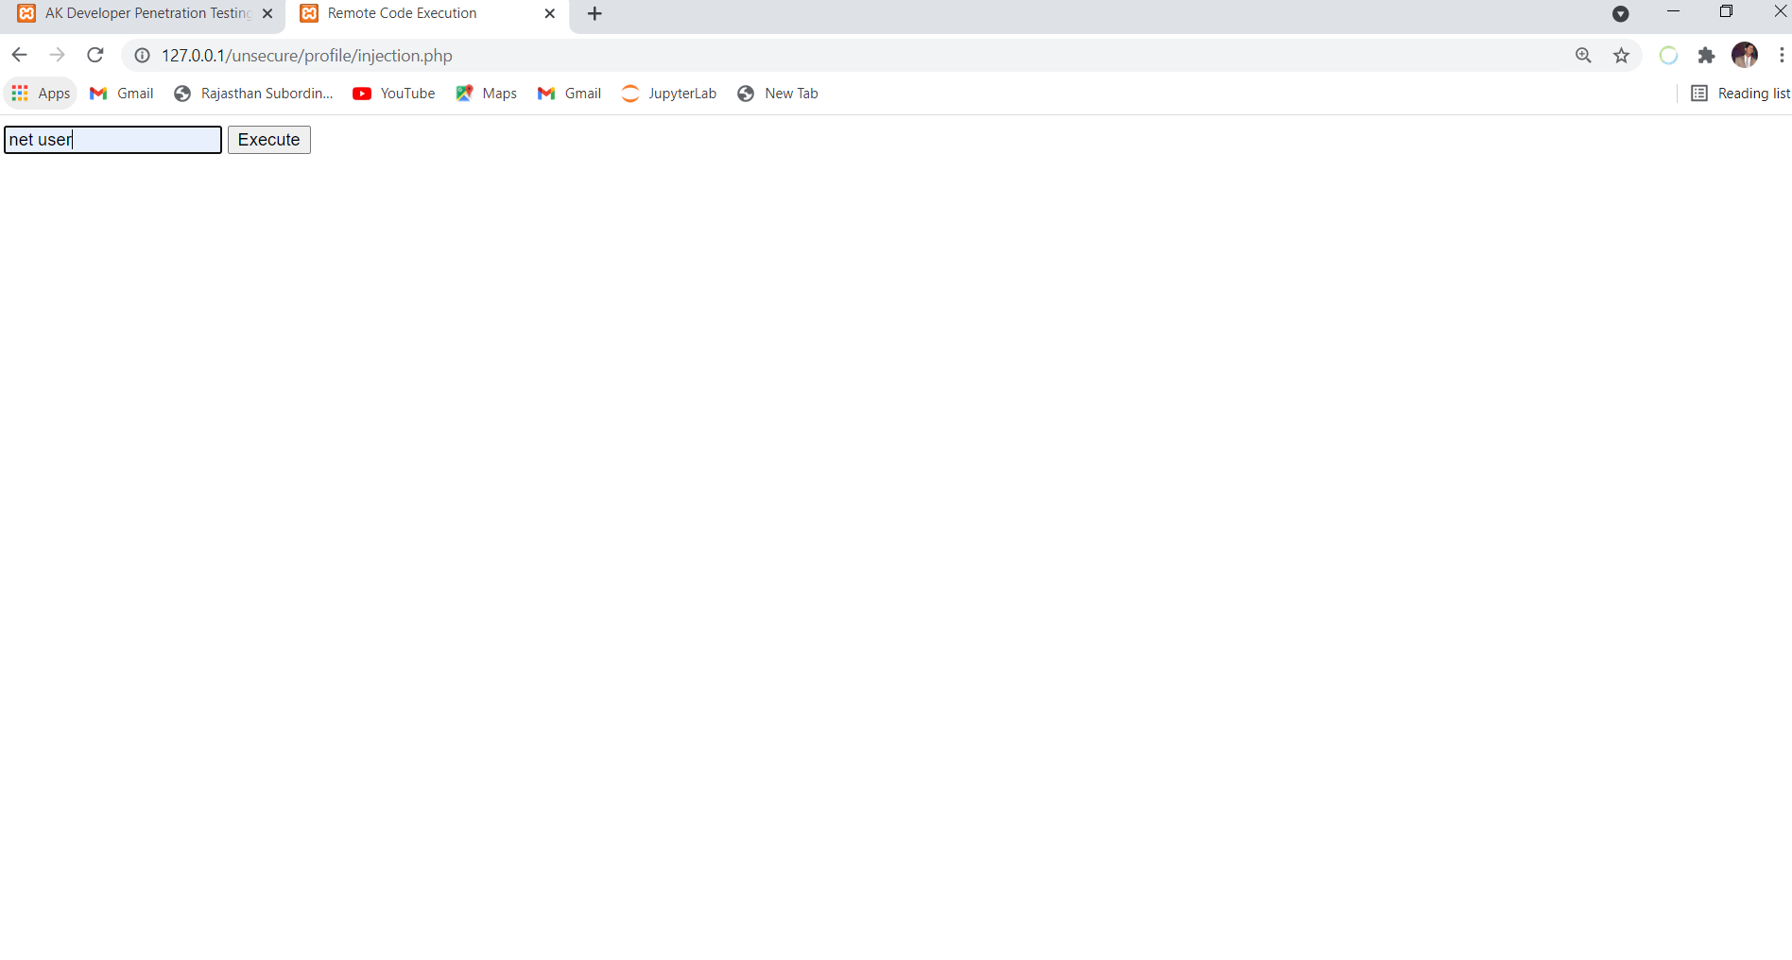
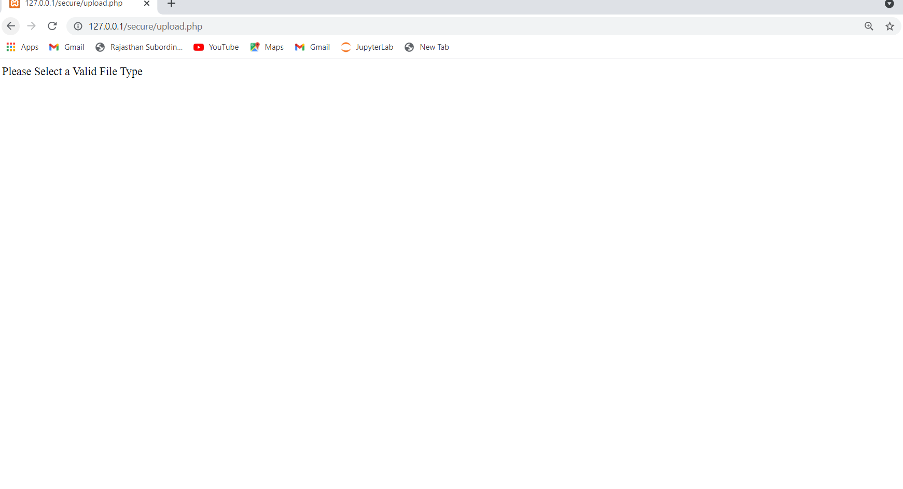

2) I login on my secured local host website then
Visit edit profile and in choose file option add injection. php file,
After that click on update then copy image address and
paste in browser then show error enter valid file whose code is in
folder secure include upload.php file in github’s technophilla
Repository
Website Penetration

